Slide 1
Ch 5 – Structured Programming
CIS 142

Slide 2
Review from Chapter four
Looping structures use conditional expressions to evaluate how many times something happens
The ++ operator is useful for counting up by one.
The -- operator is useful for counting down by one.
Placing ++ before variable (++X) or after (X++) could produce different results
The += operator adds a variable’s contents to another variable
The while loop’s condition is at the top of the loop, so the condition needs to be met before it reads the looping code.
The do. . .while loop’s condition is at the bottom of the loop, so the program runs through the looping code at least once before it reaches the condition.
The for loop is common for building loops when a number of iterations is already known
Notes:
printf (line1\nline2\nline3\n”);

Slide 3
Intro to structure design
Structured programming allows programmers to break complex programs into manageable components
In C these components are known as “functions”
There are many different concepts of structured programming, but the three we are going to be following are:
Top-Down design
Code reusability
Information hiding

Slide 4
Top-Down Design
Since multi-tasking can be hard, especially for programmers, the top-down design allows programmers to work at one problem at a time.
The top-down design can help you out of a long dark forest of system design, breaking the problem into small manageable pieces.

Slide 5
Top-Down Design
Let’s use the book’s ATM problem as an example. Suppose your boss tells you to program the software for a virtual bank. Where do you begin?
Break the problem into small, manageable pieces, starting from the top - in C the top is always the main() function.
Next identify all major components.
(Display balance, Deposit funds, Transfer funds, Withdraw funds)
Now you can start to visualize the work. Break down one major components to make it more manageable.

Slide 6
Top-Down Design
The “withdrawal funds” component can be broken down into much smaller pieces, such as:
Get available balance to amount requested
Compare available balance to amount requested
Update Customer’s account
Distribute the appropriate funds
Reject request
Print receipt
Break it down even further if you need to . . . Take “distribute approved funds”
Verify that the ATM funds exist
Initiate virtual/mechanical processes
Update bank/ATM records

Slide 7
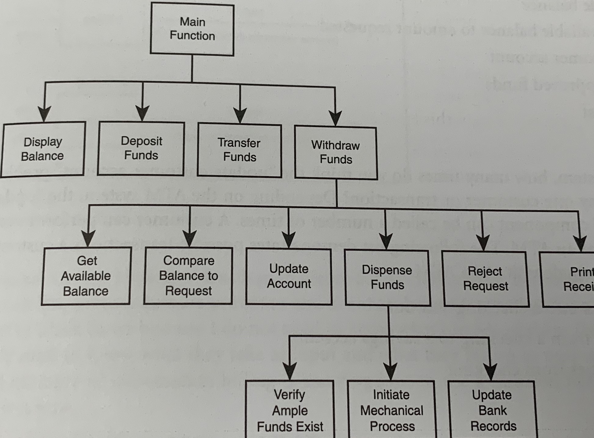
ATM Problem

Slide 8
Code Reusability
Programmers in C can use functions for problems that generally need frequently used solutions such as:
Get available balance
Compare available balance to amount requested
Update customer account
Distribute approved funds
Reject request
Putting all the code into a function that you can call on repeatedly saves you time as a programmer, immediately and in the future (if you need to make a change)
One very popular example of this is the “printf” function!
Notes:
Let’s say that a person goes to the bank and. . .
-deposits money into checking
-transfer money from checking into savings
-withdraw money from checking

Slide 9
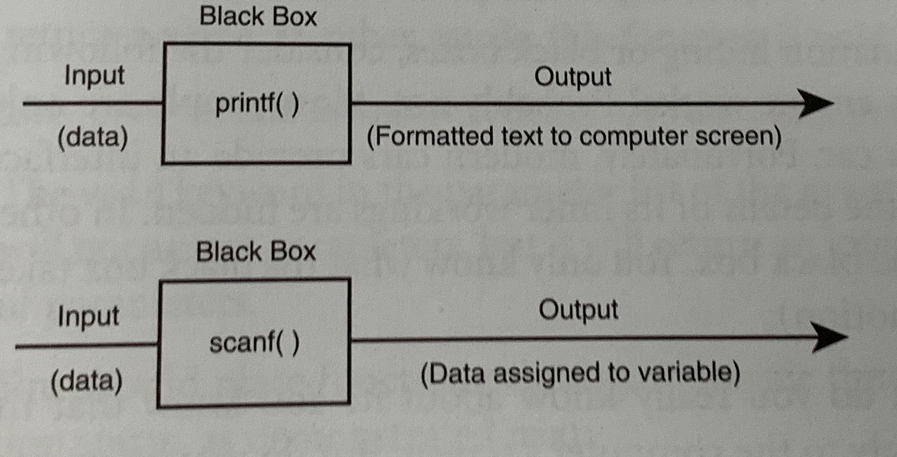
Information Hiding
This is a conceptual process by which programmers conceal implementation details into functions. (A.K.A. – Black Box)

Slide 10
Information Hiding
Most people aren’t concern that they know how something works, but that they know how to operate/use it when they need to.
Perfect example is a car engine. You input “gas” to the engine, it does something, and it outputs “motion”.
Another example is the Creston/control box for the projector in Rm 208.

Slide 11
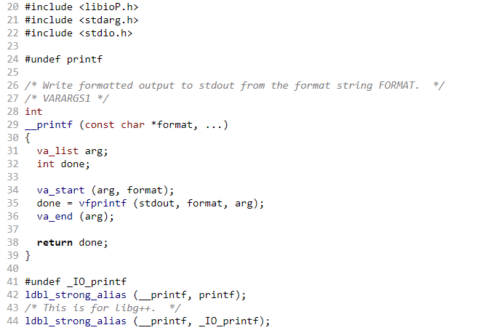
PrintF (hidden and reusable)
This file is part of the GNU C Library –click pic for vfprintf function (line 35)

Slide 12
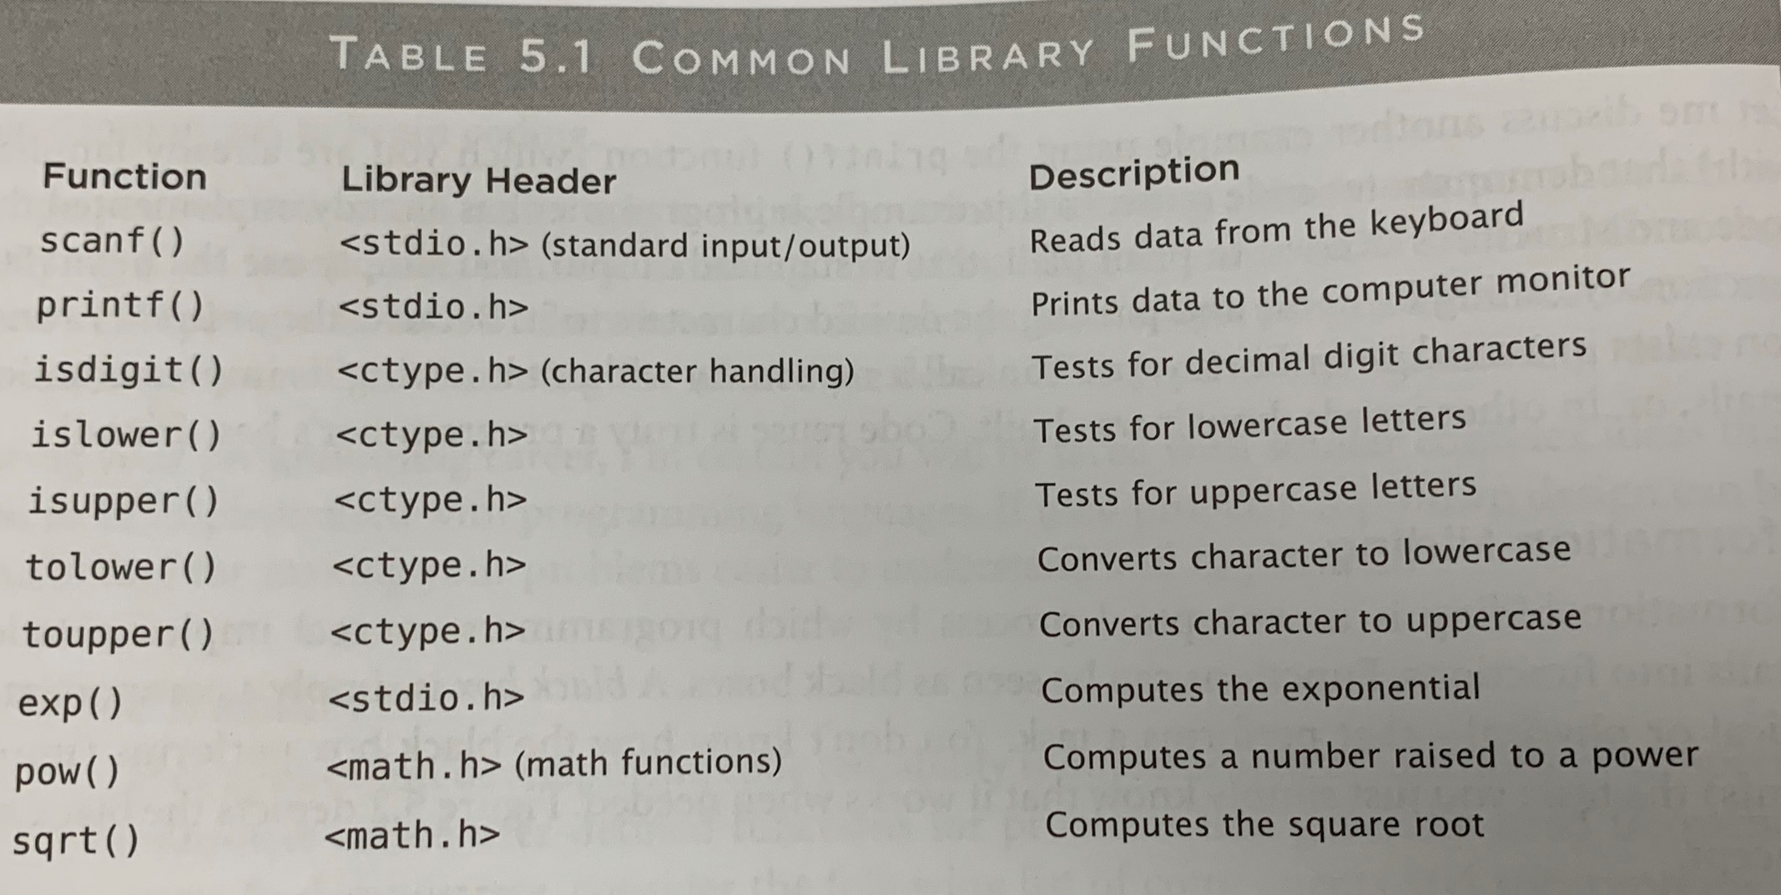
Information Hiding

Slide 13
Function Prototypes
Function prototypes tell C how your functions are to be built and used. It is common practice to construct a prototype before the actual function is built.
To do this we must think about two things. . .
How it will receive input
How and what it will return

Slide 14
Function Prototypes
float addTwoNumbers ( int, float )
This function tells us a few things
float - the data type returned
( , ) - the number of parameters received
addTwoNumbers - the name of the function
( int, float) - the type of data of the parameters
- the order of the parameters

Slide 15
Function Prototypes
Prototypes always go outside the main() function and before the main() function starts
#include <stdio.h>
int addTwoNumber(int, int);
int main()
{
}

Slide 16
Function definitions
Function Definition implement the prototype and normally comes after the main () functions
#include <stdio.h>
int addTwoNumber(int, int);
int main()
{
printf (“Nothing happens here”);
return 0;
}
int addTwoNumber ( int number1, int number2);
{
return number1 + number2;
}

Slide 17
Return ;
The keyword return can be used in two fashions
To return a value or expression result to the calling statement.
Return nothing , but give back computer control back to the calling statement.
It might not be used at all. . . .
int compareTwoNumber ( int num1, num2);
{
if ( num1 < num2)
printf (“\n %d is less than %d \n”, num1 , num2);
else if ( num1 ==num2)
printf(“\n %d is equal to %d \n”, num1 , num2);
else
printf(“\n %d is greater than %d \n”, num1 , num2);
}

Slide 18
TRY IT OUT!

Slide 19
Variable Scope
Variable scope identifies and determines the life span of any variable in any programming language.
We’ve used local scopes every time we’ve programmed thus far. Local variables are defined in functions, such as main() function; and lose their scope each time the function is executed.
Try it out!

Slide 20
Each time the program runs, C allocated memory space for the integer variable “num1”; with its variable declaration.
The data is then lost as soon as the main() is terminated.
Let’s try it out.

Slide 21
Global Variables
You can reuse the name of locally scoped variables without harming one another’s contents. At times you may want to share data between and across functions. You could then create a Global Variable.
Global variables are create and defined outside any function (. . including main() function)
Try it out. . . .

